Slide 1



2019 Work Plan
RAMSEY COUNTY 1
Ramsey County Aquatic Invasive Species Program
A Plan to Prevent, Respond to, and Manage AIS

Slide 2
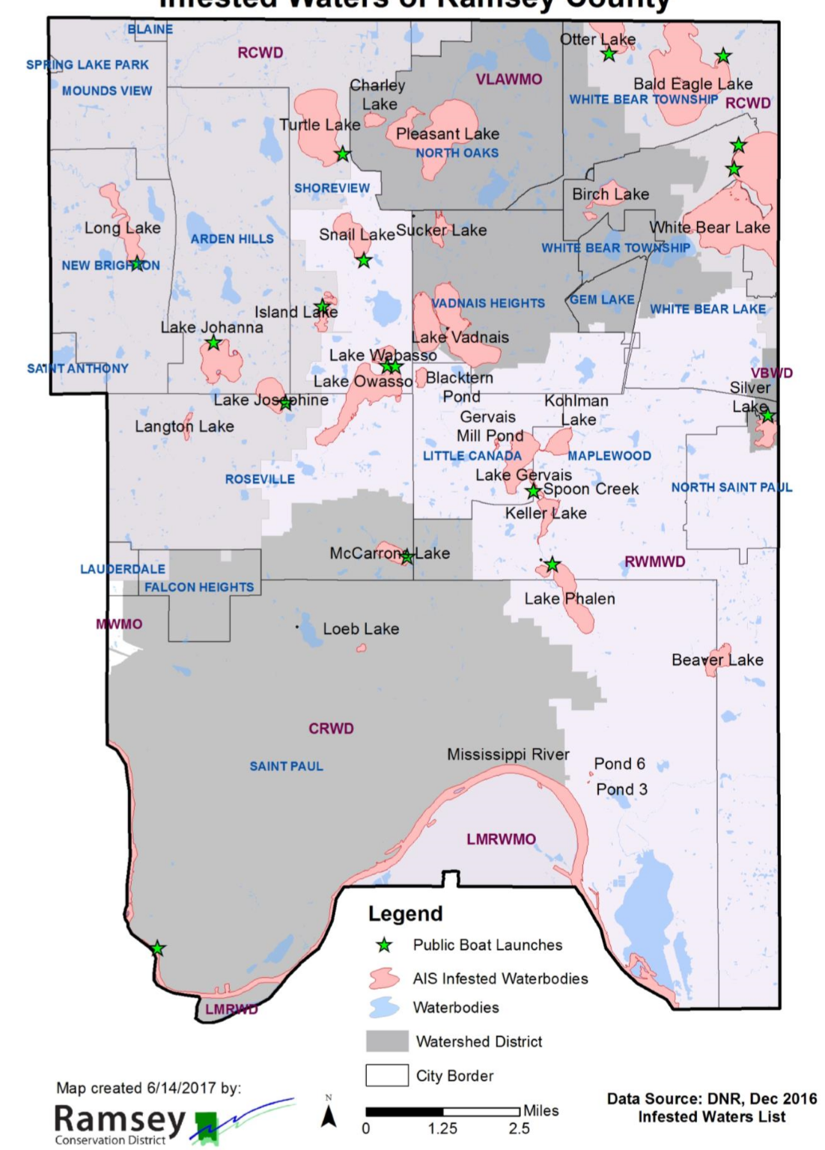
Lake McCarrons
Ramsey County Lakes
115 Waterbodies with an ID
17 trailer launch sites

Slide 3
AIS Funding
Long Lake
2014 MN Bill provides counties with AIS prevention funds directly from the Department of Revenue:
“…solely to prevent the introduction or limit the spread of…” AIS
Funding allocation based on:
  # of boat launches (50%)
  # of watercraft trailer parking spaces (50%)
Ramsey County has received:
  2014-5 $ 46,772
  2016 $ 103,937
  2017 $ 98,472
  $ 97,537
  $ 97,641
Ramsey County does not budget any money from tax dollars to AIS. Although in-kind donation of time and resources is increasing.

Slide 4

2019-2024 Five Year Strategic Plan
Strategy 1: Leverage science
& data to optimize treatments and prioritize most critical points of intervention.
Objective 1:
Prevent New Infestations
Strategy 2: Identify & Promote behaviors that can prevent AIS spread
Strategy 1: Support early detection best practices and research novel early detection methods
Mission
Objective 2:
Detect Infestations Early and New Infestation Response
Prevent the Spread of Aquatic Invasive Species (AIS) and Protect Water Resources, Critical Aquatic Habitats and the Ecosystem Services Dependent on Them in Ramsey county.
Strategy 2: Refine the new infestation response plan (NIRP) to optimize reach & impact
Civic standards are the foundation achieving goals
All those impacted by the problem are
stakeholders and help define the problem in light of civic principles and the realities of their situation.
All stakeholders are accountable for contributing resources (leadership/time, knowledge, constituencies & dollars) to solve
the problem.
All stakeholders are engaged in decision- making and policy-making that contributes to the common good.
All stakeholders implement policies grounded in civic principles in the places where they have the authority to act.
Strategy 1: Refine best practices to minimize Prohibited AIS
Objective 3:
Minimize Existing Infestations
Strategy 2: Seek partnerships to fund management
BOARD OF COMMISSIONERS 2

Slide 5
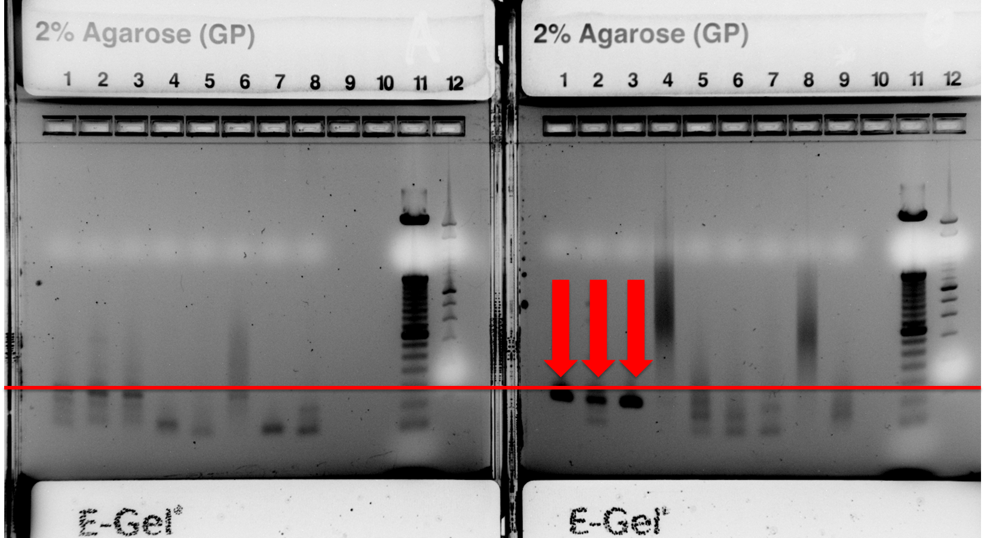
Long Lake
Future Focus:
Prevention
  Increase inspector proficiency and enforcement
  Moving towards 100% inspections or other mechanisms to ensure more boats are clean entering Ramsey County lakes
  Give people the tools
  Community Based Social Marketing
Early Detection
  eDNA early detection
  SCUBA Diving surveys
  A more robust volunteer detection program-
    Starry Trek and detectors
Response and Management
  Refinement of the New Infestation Response Plan-$ for response
  Continued partnerships with U of M-MAISRC, MN Lakes and River Advocates, Watershed Districts, Cities, and you in Civic Governance practices

Slide 6
Timeline
On July 26, 2019 an AIS Detector (citizen scientist) reported zebra mussels at McCarron Lake through EDDMaps (record # 8177304). The Detector was conducting an aquatic plant search at the public access where he discovered 6 zebra mussels attached to muskgrass.
DNR surveyed the area on August 5, 2019 and found 6 additional zebra mussel both north and south of the public landing with signs of natural reproduction in the lake. The zebra mussels were attached to rocks and muskgrass in 1-3 feet of water.
Ramsey County staff conducted a targeted search around the beach and fishing pier area on August 6, 2019 and confirmed a lakewide zebra mussel presence.

Slide 7
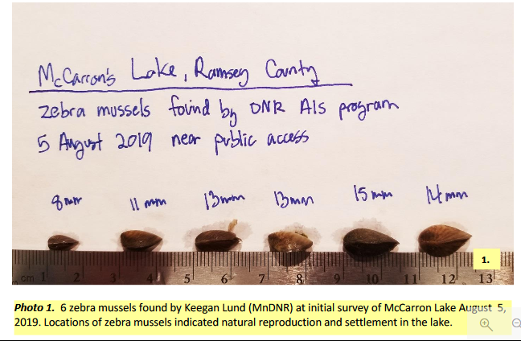

Slide 8
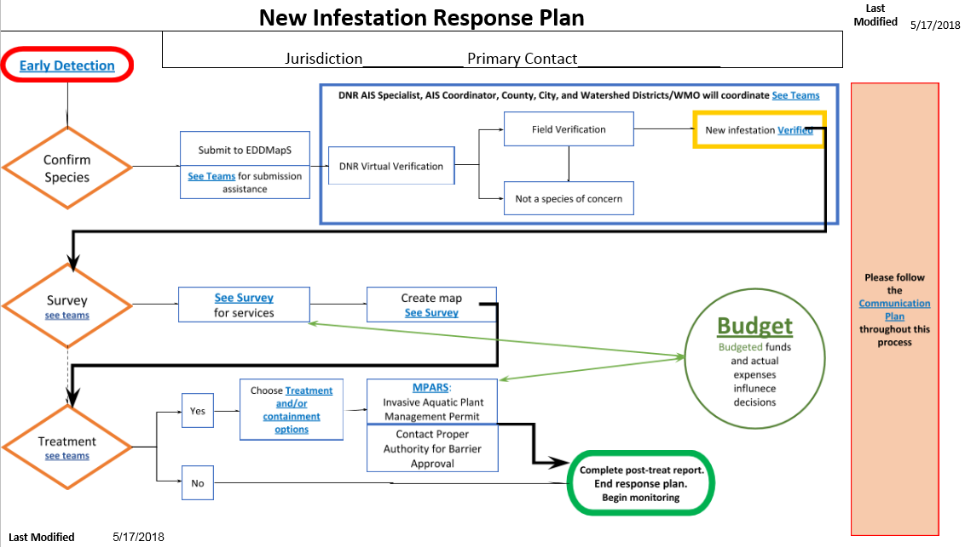
Long Lake

Slide 9
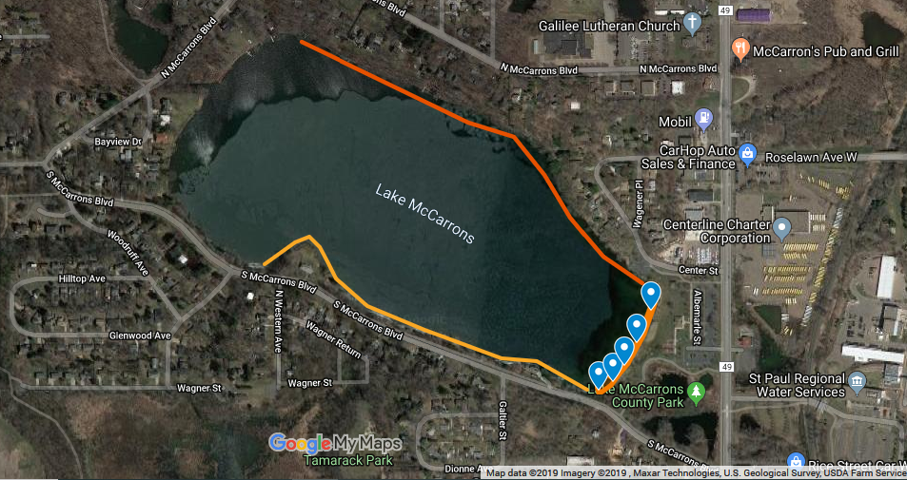
Long Lake

Slide 10
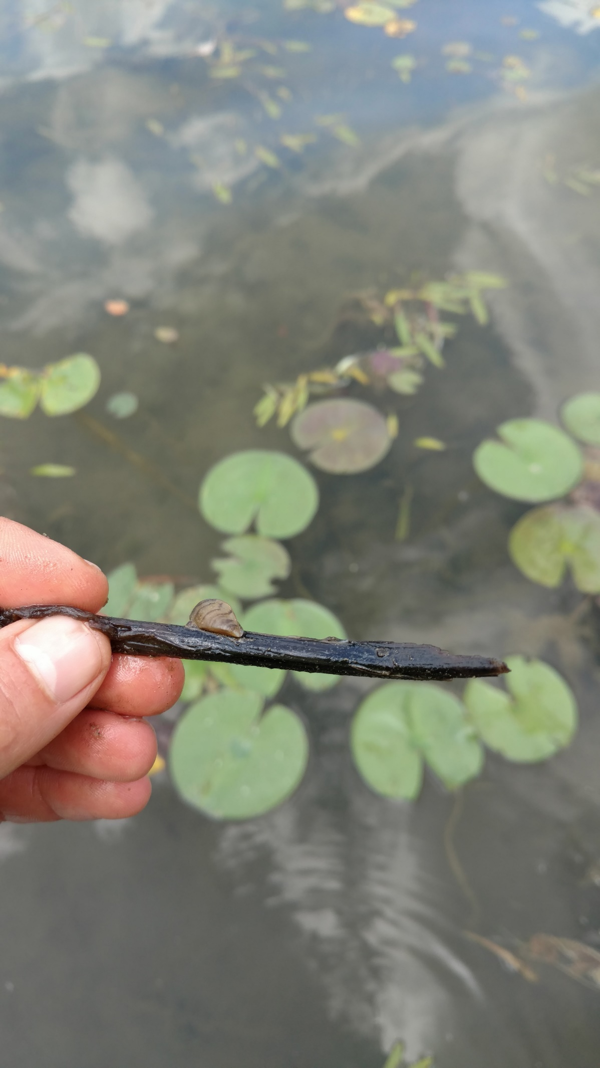
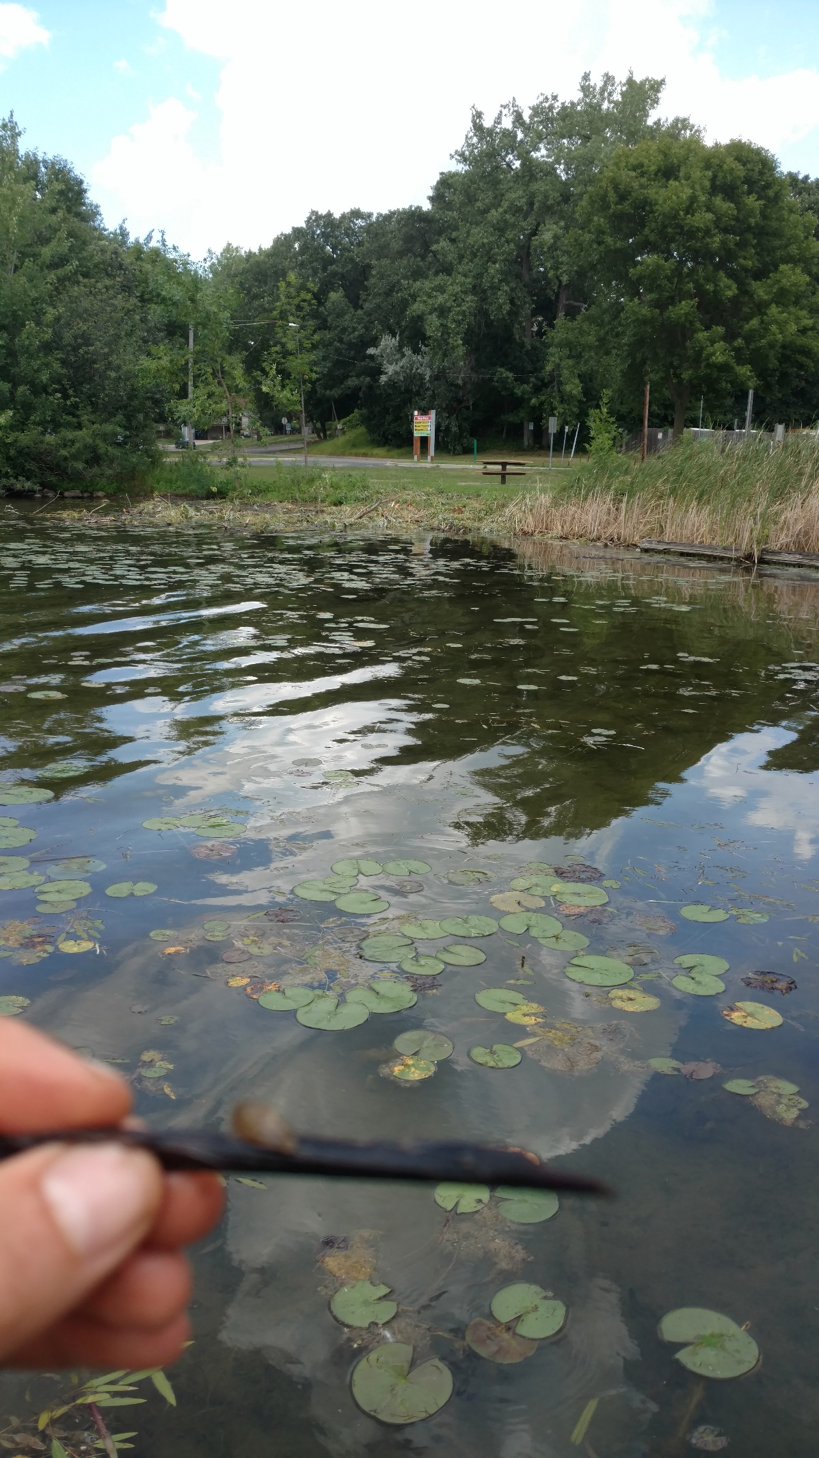
https://www.google.com/maps/d/edit?mid=1qOiZD3FCBMRl0J7IAxf4V63WUpOyfmv5&ll=44.9988617682006%2C-93.11473256625368&z=16

Slide 11
Options
Monitor-
  Study the density and nuisance factor
  Continue to monitor effects on Lake health factors
Treatment-
  Not possible due to infestation in entire lake
  Copper products with detrimental effects on all aquatic life

Slide 12
Questions?
Justin Townsend | Env. Specialist I-Aquatic Invasive Species Coordinator
Ramsey County Parks and Recreation-Soil and Water Division
1425 Paul Kirkwold Drive
Arden Hills, MN 55117
651-266-7277
Justin.Townsend@co.ramsey.mn.us

